Slide 1

guCCi gaNg

Slide 2
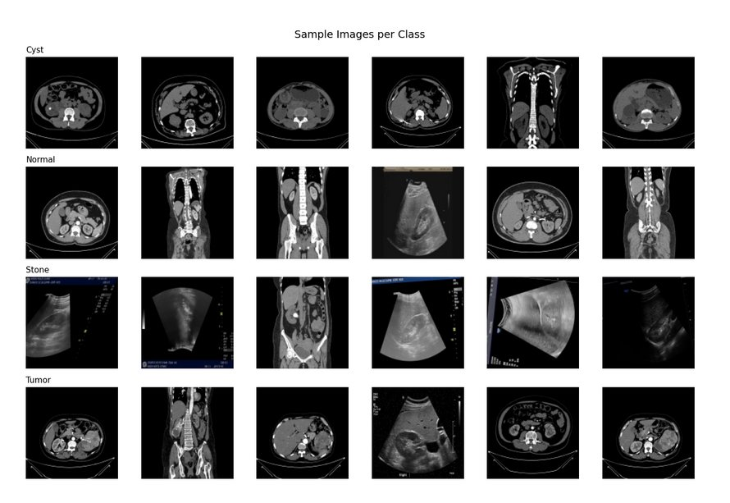
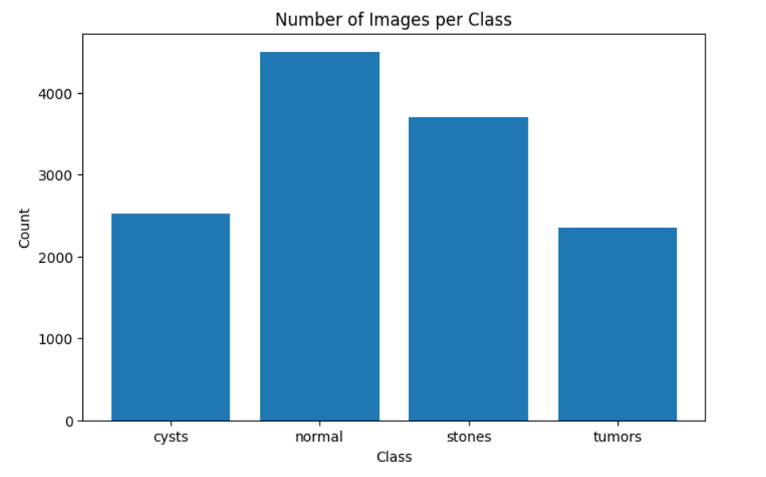
GIVEN DATA

Slide 3
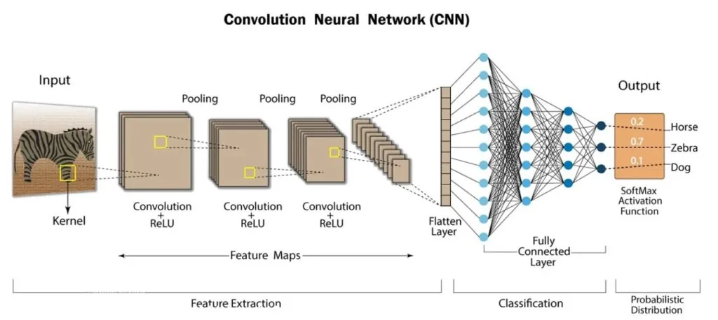
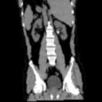
ARCHETECTURE

Slide 4
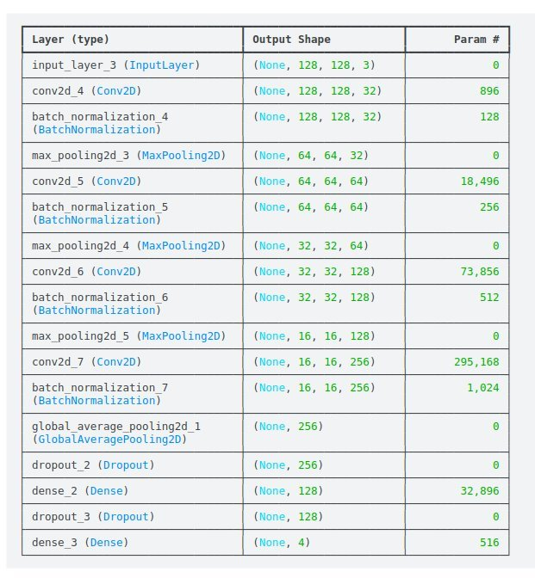

Slide 5
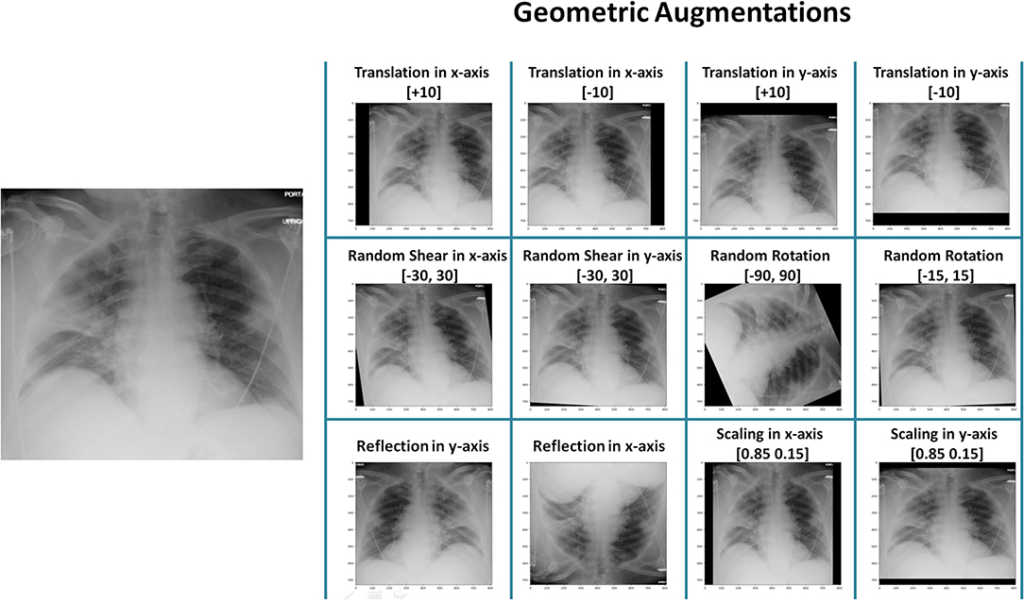
Data Augmentation & Normalization: The "What" and "Why"
What is Data Augmentation?
A technique to artificially increase training data size and diversity by applying random transformations (flipping, rotating, etc.) to existing images. The goal is to help the model generalize instead of memorize.
Why is it Crucial?
Prevents Overfitting: Stops the model from learning the training data's noise, so it performs better on new, unseen images.
Increases Dataset Size: A cost-effective way to get more data without new collection and labeling.
Improves Generalization: Makes the model robust to real-world variations in lighting, angle, and position.
How It's Implemented
"On-the-Fly" Processing: Transformations are applied in real-time to batches of images right before they enter the model for training. The model sees slightly different images each time it trains.
Built into Frameworks: Easily implemented using popular libraries:
TensorFlow/Keras: (e.g., RandomFlip, RandomRotation layers)
Common Augmentation Techniques
Geometric Transformations:
Flipping: Mirroring the image horizontally or vertically.
Rotation: Turning the image by a random angle.
Scaling & Cropping: Zooming in/out or selecting a random section.
Translation: Shifting the image's position.
Color & Other Transformations:
Brightness & Contrast: Adjusting the image's lighting properties.
Adding Noise: Simulating lower-quality images.
Cutout / Random Erasing: Forcing the model to learn from incomplete objects by masking a random area.

Slide 6
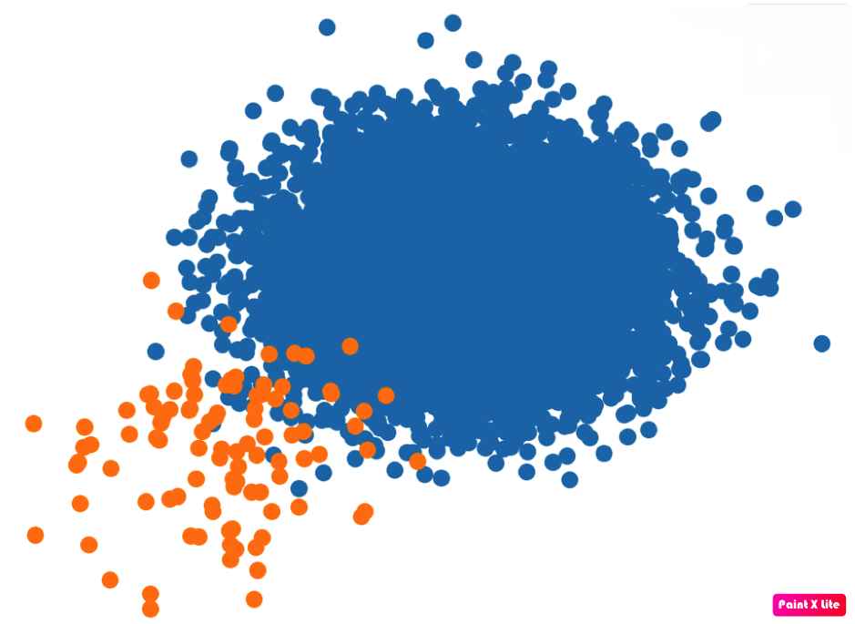
The Challenge of Imbalanced Datasets
Many real-world datasets are imbalanced.
Example: A dataset for fraud detection with 99% non-fraudulent transactions and only 1% fraudulent ones.
The Problem:
A naive model can achieve 99% accuracy by simply always predicting "not fraud." This model is useless because it fails at its main task: detecting the rare but critical cases.
The next two strategies directly address this problem.
Advanced Strategy 1: Balanced Batch Sampling​
Advanced Strategy 2: Class Weights​

Slide 7
Advanced Strategy 1: Balanced Batch Sampling​
The Core Idea​
Change how the data is shown to the model during training.​
How it Works​
Instead of picking images randomly, you strategically build each training "batch" to have a more equal representation of each class. This is done by oversampling the minority class (showing its images more often).​
Analogy: You're studying for an exam with 90 pages on Topic A and 10 on Topic B. Instead of studying random pages, you decide to study 5 pages of Topic A and 5 pages of Topic B in every session to give both equal attention.​
Result​
The model gets an equal perspective on all classes in every training step, preventing it from becoming biased.
​Advanced Strategy 2: Class Weights​
The Core Idea​
Change how much the model is penalized for making a mistake.​
How it Works​
You modify the model's loss function. Misclassifying an image from the rare minority class results in a much higher penalty than misclassifying one from the common majority class.​
Analogy: On a quiz, a regular question costs you 1 point if you get it wrong. But a special "bonus" question on a rare topic costs you 10 points if you get it wrong. You'll study much harder for that rare topic to avoid the huge penalty.​
Result​
The model is forced to learn the features of the rare class to avoid the heavy penalty.

Slide 8
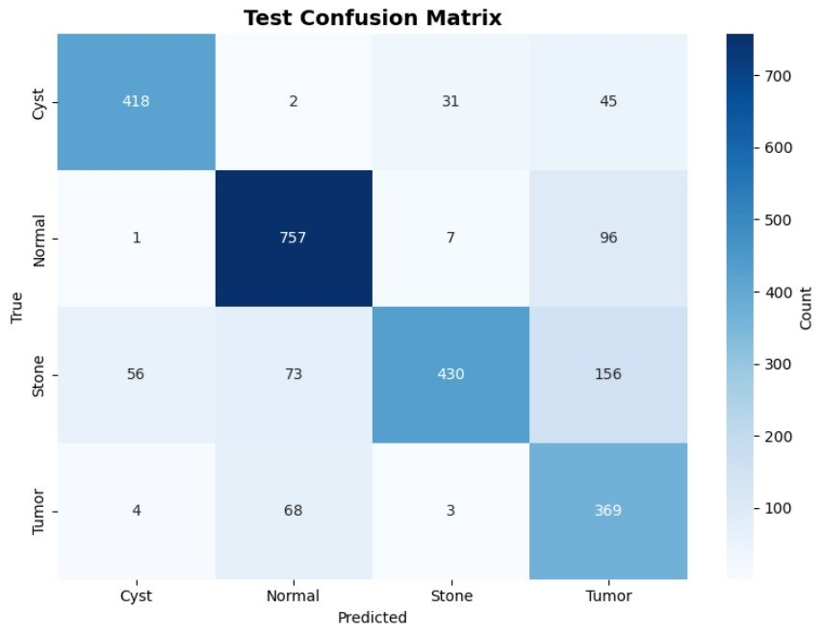
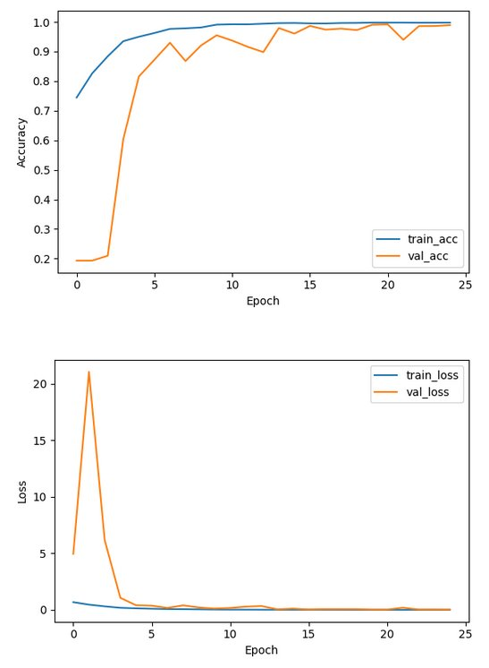
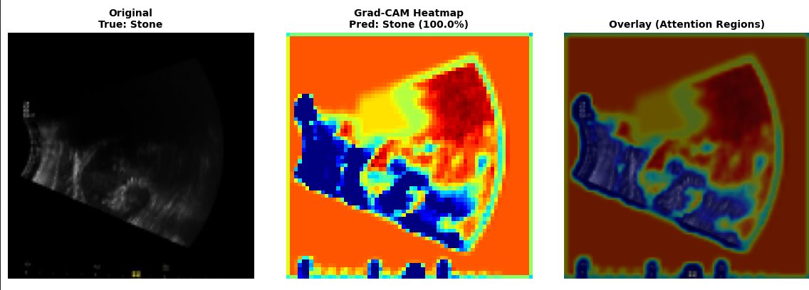
RESULTS

Slide 9
Focal Loss: Focusing on the Hard Stuff in Deep Learning
The Core Problem: Class Imbalance One of the persistent challenges in deep learning, particularly in tasks such as object detection and medical image classification, is class imbalance. This occurs when one class in the dataset is much more frequent than the other(s).
2. The Standard Approach: Cross-Entropy Los
The most widely used loss function in classification is Cross-Entropy (CE) Loss. It measures the difference between the predicted probability and the actual label:
CE(pt​)=−log(pt​)
where pt​ is the model’s predicted probability of the true class.
The flaw in CE for imbalanced datasets is that it treats all examples equally. Since the dataset is dominated by easy, negative examples, these overwhelm the loss function. As a result, the signal from the relatively few hard positive examples is drowned out. The model ends up learning to recognize the majority class very well while neglecting the minority class.
3. Focal Loss: The Solution
To address this, researchers introduced Focal Loss. The central idea is to reduce the relative loss contribution of easy examples, allowing the model to focus more attention on the hard, informative ones.
The focal loss formula is:
FL(pt​)=−αt ​(1−pt​)^{γ} log(pt​)
It introduces two new parameters:​
γ (gamma): the focusing parameter, which dynamically scales down the loss of well-classified examples.​
α (alpha): the balancing parameter, which provides a static weighting to counter class imbalance.​
Together, these terms modify standard cross-entropy into a more robust loss function tailored for imbalanced learning.​
​

Slide 10
​
4. Understanding γ (Gamma): The Focusing Parameter​
The focusing parameter γ is the key innovation of focal loss. It adds a modulating factor (1−pt​)γ.​
For easy examples (where the model is confident, pt​→1):​
(1−pt​) becomes very small.​
The overall loss is down-weighted significantly.​
The model spends less time relearning what it already knows
​
5. Understanding α (Alpha): The Balancing Parameter​​
While γ adjusts the emphasis between easy and hard examples, α counterbalances the class imbalance itself. It assigns a fixed weight to each class.​​
For instance, in a binary task where positives are rare, you might set α=0.25 for the positive class, and 1−α=0.75 for the negative class.
This ensures that rare positives are not overshadowed by the overwhelming number of negatives.​​
Thus, α addresses inter-class imbalance, while γ addresses intra-class difficulty. They complement each other, making focal loss powerful in domains with rare but crucial samples.​​
​​
For hard examples(where the model is wrong, pt​→0):​​
(1−pt​) is close to 1.​​
The loss remains nearly unchanged.​​
The model is forced to pay more attention to these mistakes.​​
In practice, γ is often set to 2.0, which provides a good balance. With this value, an easy example with pt​=0.9 contributes about 100 times less loss compared to cross-entropy, while the loss for a hard example (pt​=0.1) is largely preserved.​​
​

